Slide 1
MULTIMODAL AI
It means working with multiple types of data: text, images, audio, pdf, etc.

Slide 2
Multimodal AI Models
Interprets the writing, diagrams, and relationships between the concepts
Handwritten notes in image or pdf
Output:
1. Text: summary, explanation
2. Audio: a spoken explanation

Slide 3
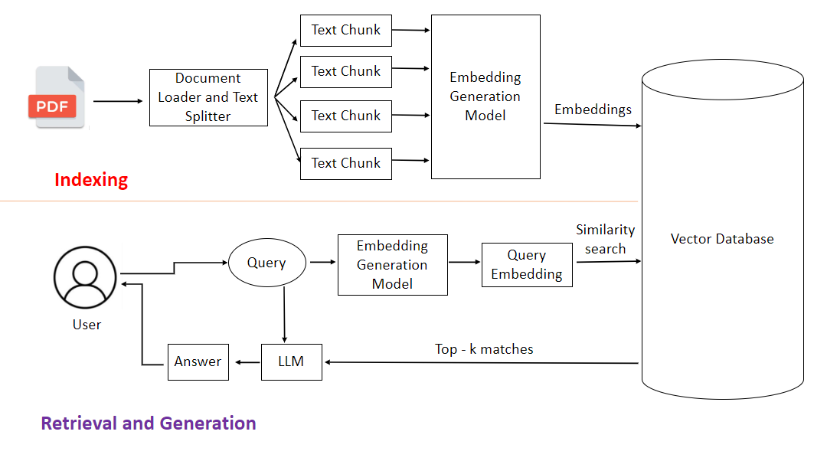
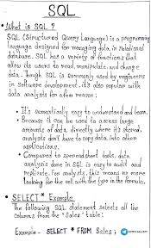
Multimodal Tutor agent
It is an AI application that helps students understand learning material from images, pdf documents
Lets say we are studing SQL and RAG, we have received these notes.
We want to use this AI App:
  to explain uploaded image,
  create notes,
  give 5 q&a based on the image,
  generate audio explaination
Use langsmith:
  To track LLM calls,
  Token consumption
  Execution time
  Outputs
  errors

Slide 4
Langsmith tracker
OpenAI Key

Slide 5
Tata motors - Azure account
India Subscription- INR
USA Subscription - USD
T1- Analytics
(RG- RG_analytics)
Azure SQL db
Azure SQL server
T1- AI solutions
T2-Infra management
T2- Data engineering (D.E.)
(RG- RG_de)
Azure Data Lake Storage
-Azure Data Factory
T3- D.E. team

Slide 6
Business requirements
Gather BR- BA
Technical requirement
Technical manager
Working solution in docker format
AI Engineer
Deployed code on cloud
DevOps

